Slide 1
What is the difference between Machine Learning and AI? If it is written in Python it is probably Machine Learning and if it is written in PowerPoint it is probably AI

Slide 2
Conversational AI
Conversational AI is a subfield of artificial intelligence focused on producing natural and seamless conversations between humans and computers
A new user interface paradigm
Exposes software services through conversational interface
In apps, browser and on IoT devices
Pro-active capabilities (Virtual Assistant etc.)
Bots

Slide 3
Bot Framework V4
GA - C# and Java Script
C# support .NET Core
Python and Java - still in preview
Incorporates learnings from V3
Open, Modular and extensible architecture
Agile and customizable dialog system
Share the same implementation across C#, Java Script, Java and Python
Rich visual controls (cards, buttons, images, videos, adaptive cards)
Seamless integration with Azure and Cognitive Services
Modern toolchain (streamline development and deployment)
Open Source and rich ecosystem

Slide 4
Microsoft Bot Framework

Slide 5
The Lifecycle of your Project
Comprehensive framework for the lifecycle of your project
Plan
Build
Test
Publish
Connect
Evaluate
Author Dialogs
Design Cards
Visualize
Bot Builder SDK
Cognitive Services
Getting Started Templates
Emulator​
Application Insights
Conversation Transcripts
DevOps Tools
Azure
BYO Web Host
WebChat
Cortana
Skype, FB
+
Custom (DirectLine)
Application Insights
LUIS Suggestions

Slide 6
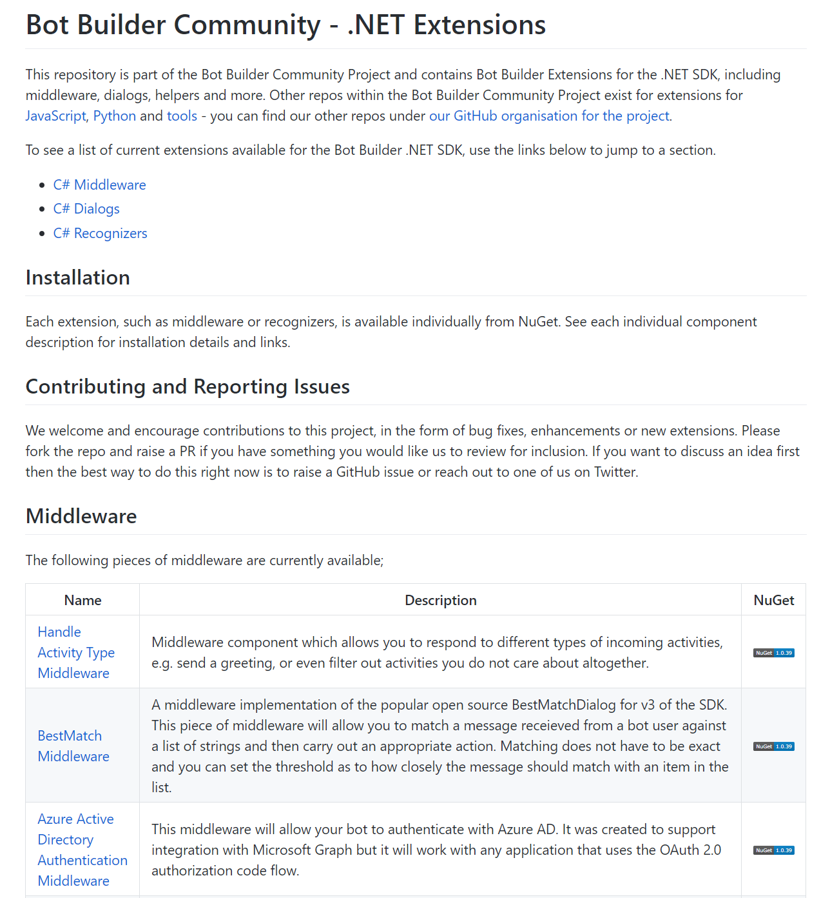
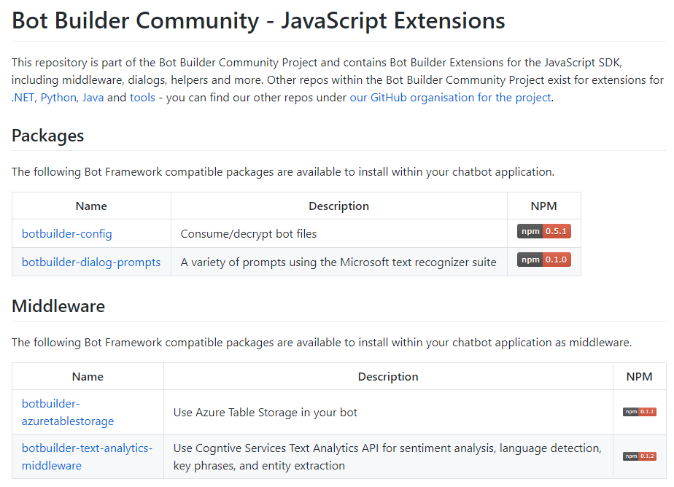
Community Driven Bot Extensions
https://github.com/BotBuilderCommunity
Extending the core Bot Framework SDKs
Middleware, dialogs, helper
Gary Pretty (https://github.com/garypretty)
James Mann (https://github.com/jamesemann)
Arafat Tehsin (https://github.com/arafattehsin)
Michael Szul (https://github.com/szul)
Stephan Bisser (https://github.com/cloudguy-pro)

Slide 7
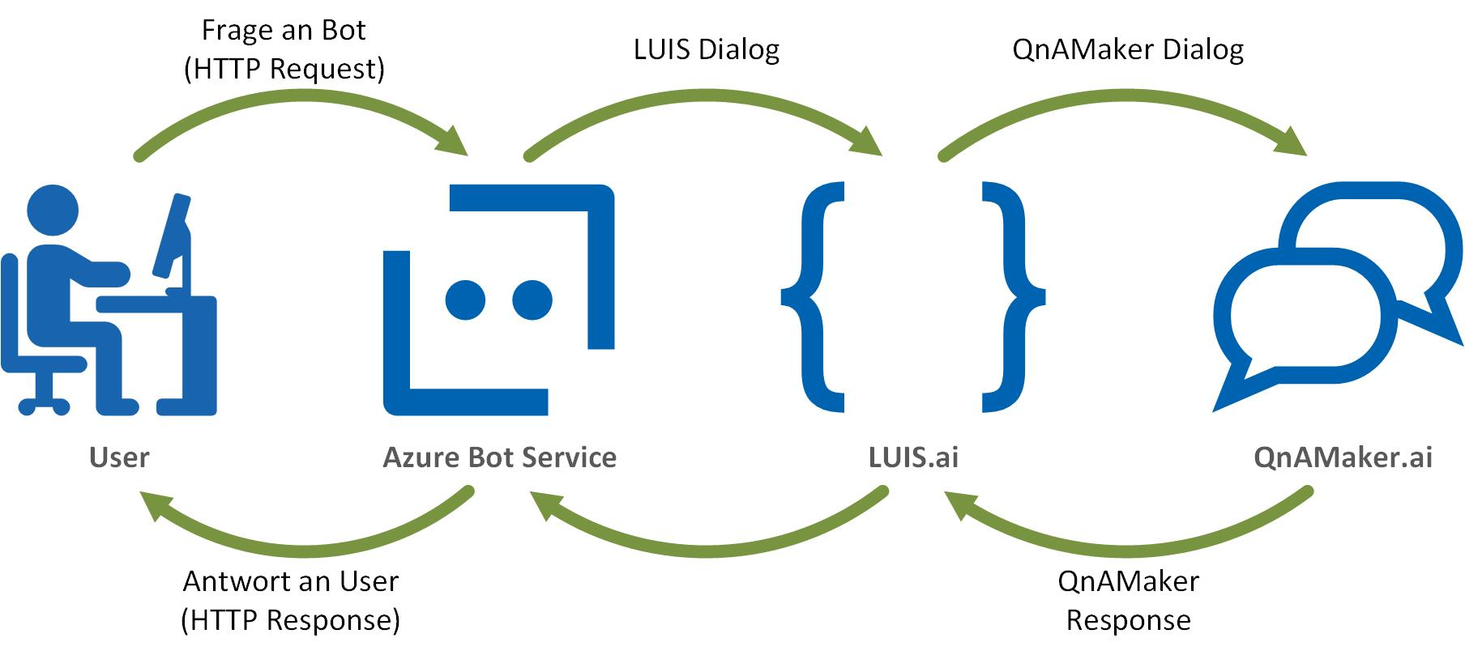

Slide 8
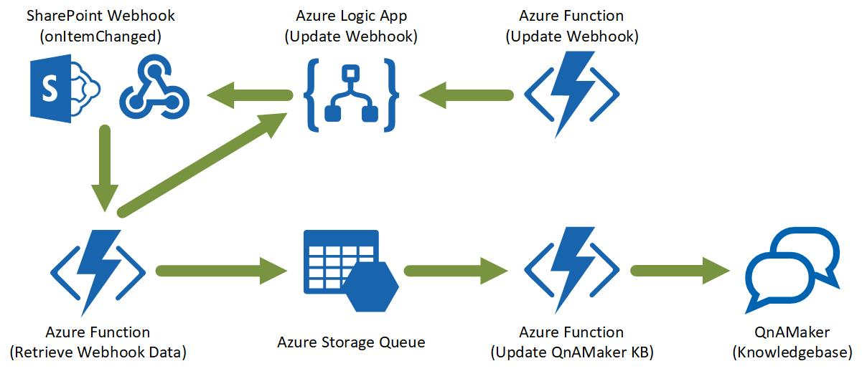

Slide 9













Channels
Knowledge
Sources
Conversational AI
Azure Bot Service + Cognitive Services
General Knowledge
Knowledgebases
AI Capabilities
User
Input
Azure Bot
Services
Data Sources
Speech
Bot Features:
Personality
Dialogs
Language Model
Tap
Adaptive Cards
Type
Speak
QnA
Language Understanding
Vision
Devices
LOB Apps
On premises
Enterprise stores

Slide 10


